Slide 1
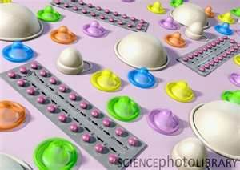
Different types of contraception
IGCSE Biology
https://www.drugs.com/drug-class/contraceptives.html
Contraceptives are the name given to medicines and other devices that are used to prevent unwanted pregnancy. Contraceptives may also be referred to as birth control.

Slide 2

Overview of contraception
Chemical methods (usually hormone involved)
Physical barriers
Natural methods (behavioral methods)
Sterilization (Surgical methods)

Slide 3
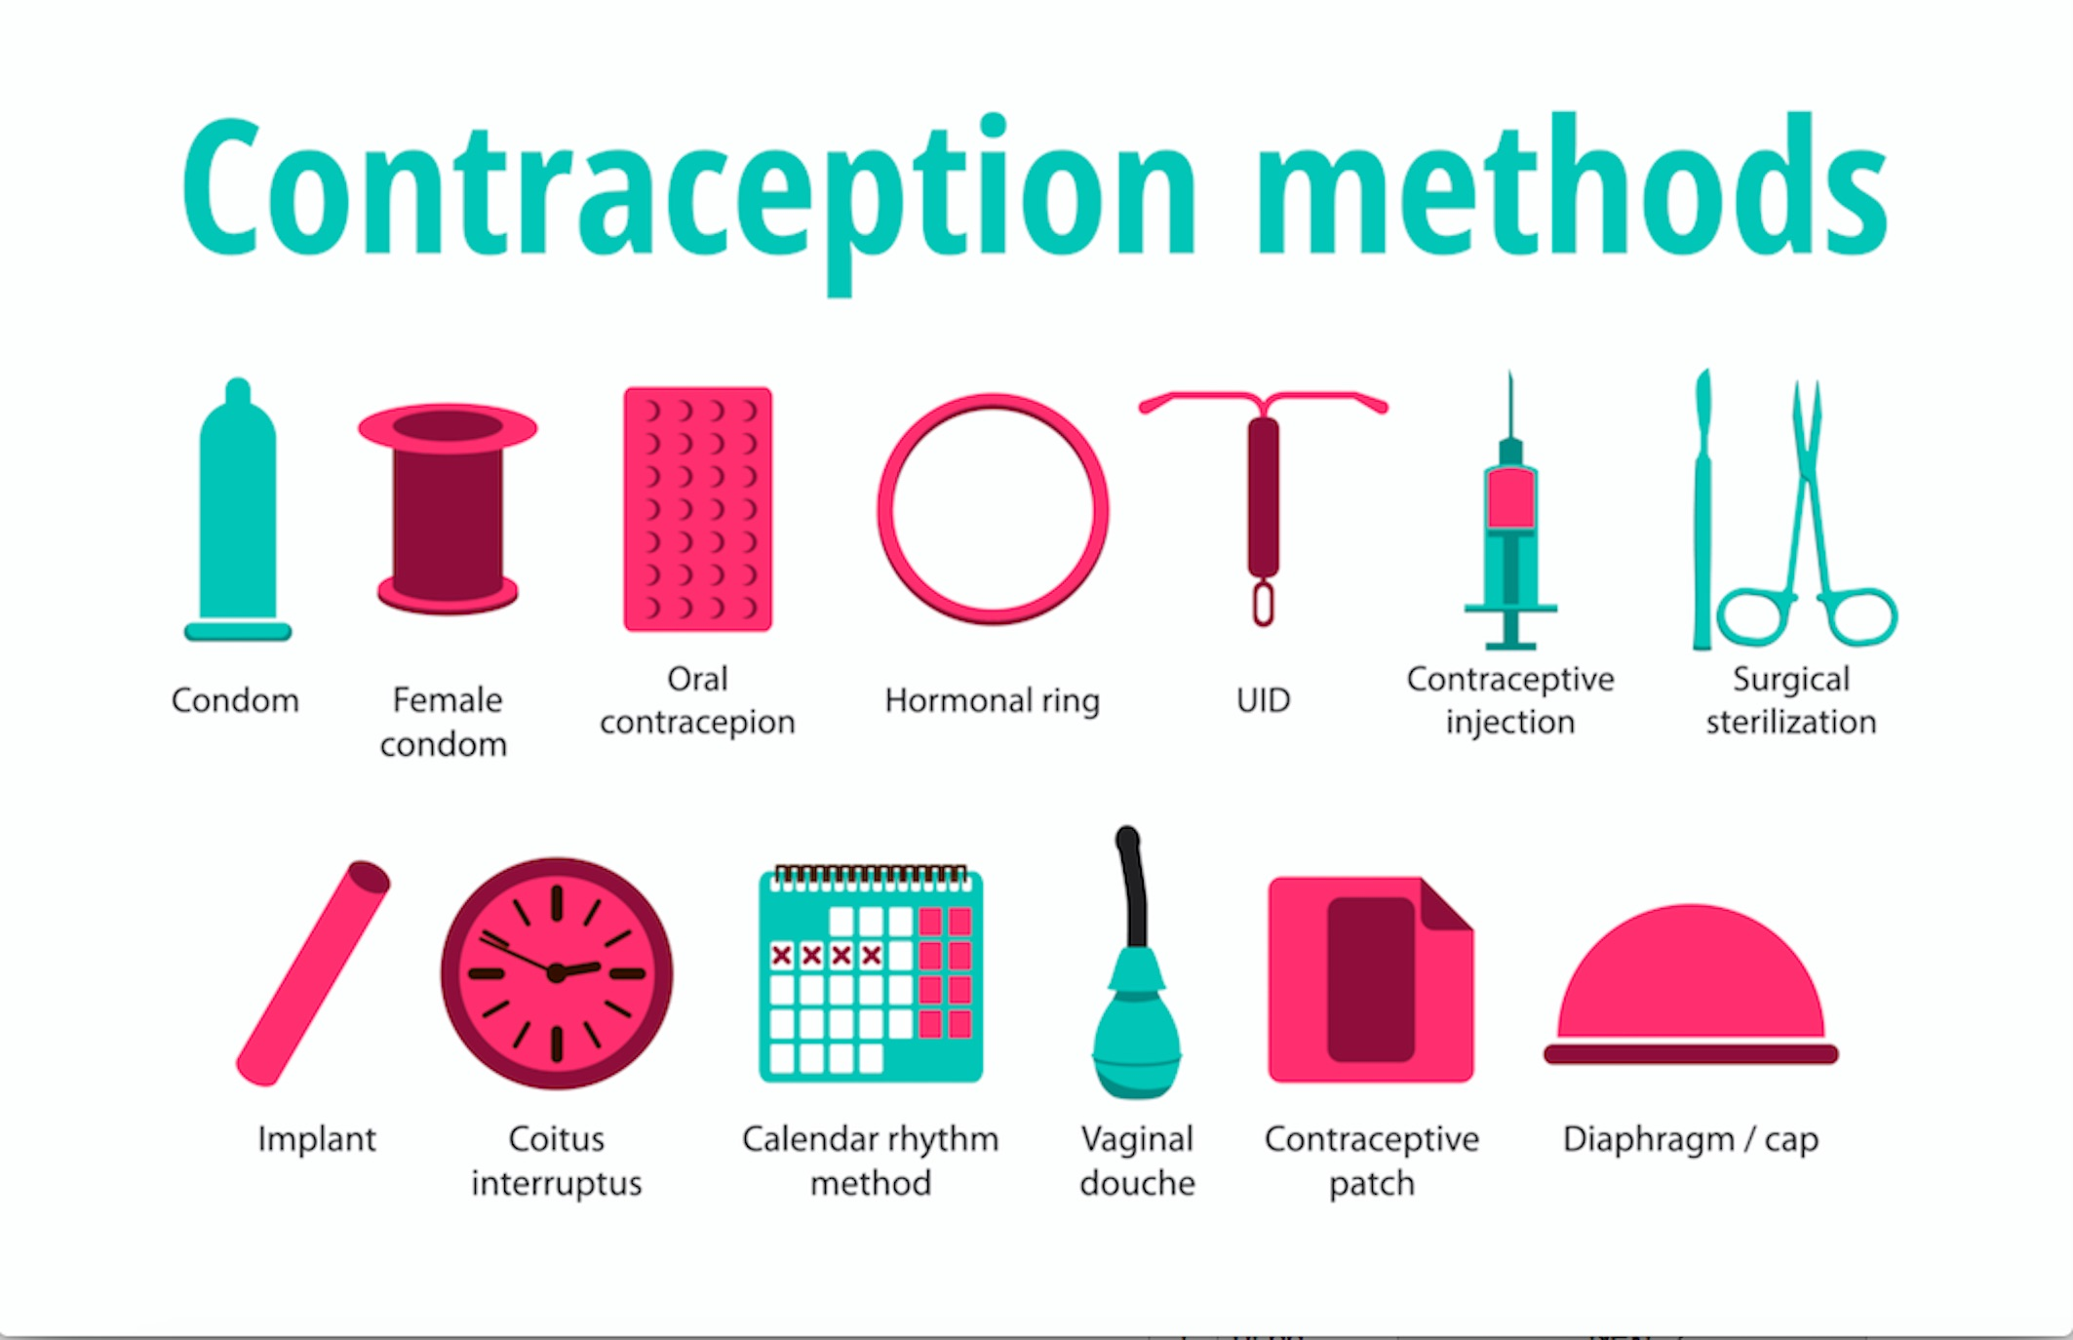
There are several differences between contraceptives. The main difference is that some contain hormones whereas others do not.
Hormone-containing contraceptives have more side effects than nonhormonal contraceptives.
Notes:
Hormonal contraceptives may not be suitable for some women especially those with certain types of cancer, at higher risk of clotting or strokes, liver disease, severe headaches, undiagnosed vaginal bleeding, uncontrolled high blood pressure or heart disease. Nonhormonal methods of contraception are more suitable for these women.

Slide 4
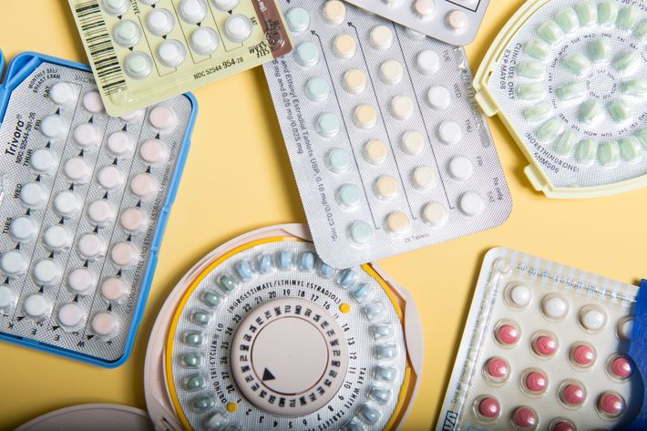
Chemical
The Pill
The pill contains progestin ( or together with oestrogen) which prevents ovulation, thins the uterine lining/ endometrium, making it less receptive to a fertilized egg and thickens cervical mucus (change the viscosity/ stickiness of mucus )
They also within the cervix to make it hard for sperm to travel to the uterus.
Pill packs containing regular birth control pills have either 21 or 28 pills. Twenty-one-day pill packs contain 21 active pills. Twenty-eight day pill packs contain 21 active pills and 7 inactive (placebo) pills.
When you forget to take a pill, you increase the chance of releasing an egg from your ovary.
Notes:
The word “progestogen” refers to any hormone product that affects the uterus in much the same way as our natural progesterone. Effective synthetic versions of progesterone, called progestins,
One of progesterone's most important functions is to cause the endometrium to secrete special proteins during the second half of the menstrual cycle, preparing it to receive and nourish an implanted fertilized egg.
Some women choose to take a progestin-only pill. Called the "mini-pill," progestin-only pills allow women to avoid some of the worst side effects of estrogen, while improving regular menstrual cycles and preventing pregnancy. If you are breast-feeding, you may want to consider the mini-pill, since combination products may dry up your milk supply.
Progestin-based mini-pills are highly effective for preventing pregnancy (about 97 percent), but missing a pill or taking it at a different time of day is riskier than with combination estrogen-progestin pills. That's because the mini-pill's effects can wear off after a day, making you vulnerable to pregnancy. Women on mini-pills may also ovulate, even when they take the pills correctly. And if you miss a day, the potential availability of an egg makes getting pregnant more likely.
Estrogen promotes buildup of the endometrium (the uterine lining), which can lead to cancer. Incorporating a progestogen prevents estrogen from building up the lining of the uterus and ensures the excess tissue will be sloughed off.

Slide 5
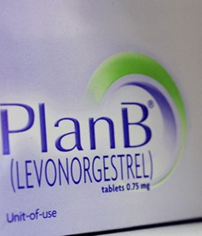
Chemical
‘Morning after’ Pill/ emergency contraceptive
Stops fertilised eggs from implanting in the uterus.
Some has to be taken within 72 hours after intercourse.
Emergency contraceptives are contraceptives that are taken (or inserted if a copper IUD) within a few days after unprotected sex to help prevent implantation of a fertilized egg and a possible resulting pregnancy.

Slide 6
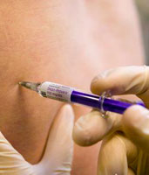
Chemical
Injected contraceptives (long-acting)
Release progesterone into the blood (over 2-3 months).
They prevent the ovaries from releasing eggs.
If you do not want to become pregnant, and if you are not likely to remember to take a pill each day, you probably should consider a longer-acting form of birth control, such as the injection (2-3 months), patch (one per week), implant (may last up to 3 years), vaginal ring (21 days) or IUD (last 3-10 years).
Notes:
One patch is applied each week for every three weeks, then usually followed by a patch-free week.
Small implantable rod the size of a matchstick that is implanted under the skin of the upper arm. Lasts up to 3 years.
Shot/injection is given by injection under the skin once every 3 months (12 to 14 weeks).

Slide 7
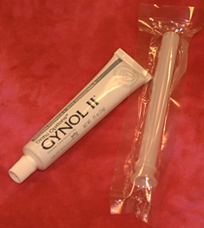
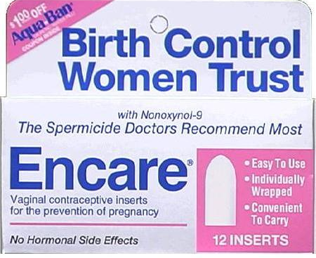
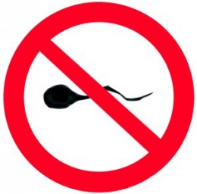
Chemical
Spermicides
These are chemicals which kill sperm cells.
They are injected into the vagina before intercourse.
Usually used with other means such as a diaphragm.

Slide 8
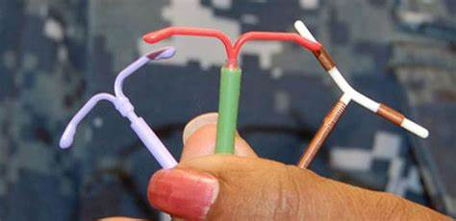
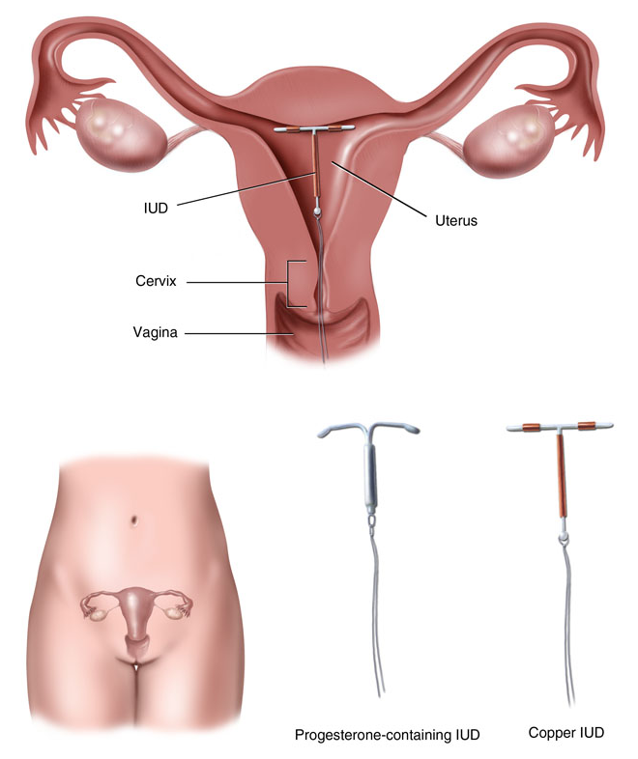
Chemical
I.U.D.(Intra-Uterine Device)
In the UK, the term IUD refers only to these copper devices. Hormonal intrauterine contraception is considered to be a different type of birth control and is labeled with the term intrauterine system (IUS).
Copper IUDs primarily work by disrupting sperm mobility and damaging sperm so that they are prevented from joining with an egg.
A small, T-shaped device which is placed inside the uterus, and which prevents the developing embryo from implanting in the uterus lining. Lasts 3 to 10 years depending on the type
Reversible and widely used.

Slide 9
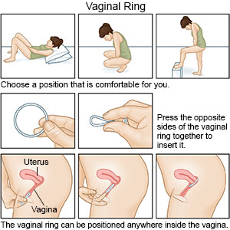
Chemical
A vaginal ring is a small flexible ring that sends hormones into your vagina. The vaginal ring may be used to prevent pregnancy. It may also be used to treat symptoms, such as vaginal dryness and itching, that occur with menopause.
You need a prescription from your healthcare provider.
If you are using the vaginal ring as birth control , keep it in place for 21 days in a row. After 21 days, you take it out for 7 days. You should have your menstrual period during this 7 days.
After the 7 days, place a new ring in your vagina, even if your period has not stopped.

Slide 10
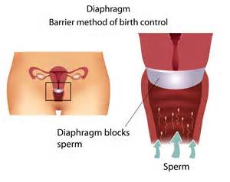
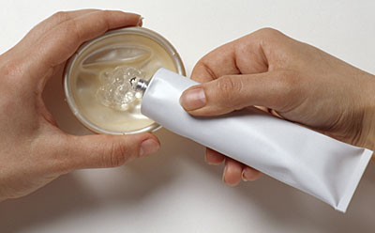
Physical
Cap (Diaphragm)
A rubber dome or soft silicone cup which covers the cervix and is inserted before sex.
It prevents sperm from entering the uterus.
(Usually used with a spermicide.)

Slide 11
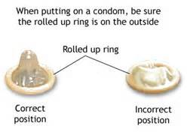
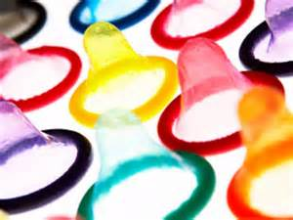
Physical
Condom
A thin rubber tube placed over the erect penis before intercourse.
It prevents sperm from entering the vagina.

Slide 12
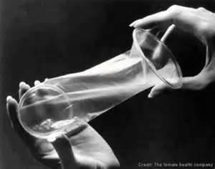
Physical
Femidom
(Female condom)
A thin rubber tube placed in the vagina before intercourse.
It prevents sperm from entering the vagina.

Slide 13
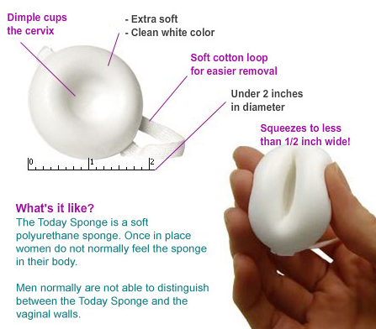
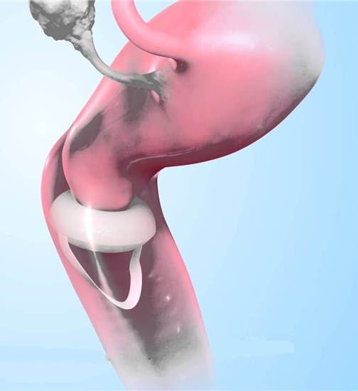
Physical
Like diaphragms, contraceptive sponges are inserted vaginally before intercourse and must be placed over the cervix to be effective.
The sponge can be inserted up to 24 hours before intercourse and must be left in place for at least six hours afterward.

Slide 14
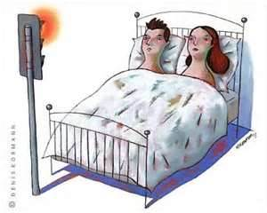
Natural
Safe Period
(Rhythm method)
Know when to have sex to avoid pregnancy
Avoids intercourse on the days when the woman is most fertile, i.e. around ovulation.

Slide 15
Natural
Abstinence
not having sex at all.

Slide 16
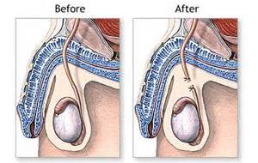
Surgical/ sterilization
Vasectomy
An operation which cuts and ties a man’s sperm tubes.
Men can still ejaculate after having a vasectomy, but there are no sperm in the semen.

Slide 17
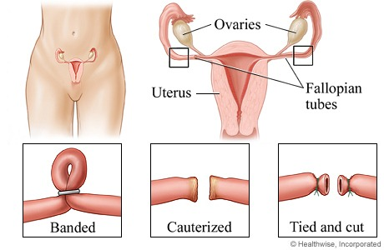
Surgical/ sterilization
Tubal ligation
An operation which cuts and ties a woman’s oviducts.
The procedure is not usually reversible.

Slide 18


